Slide 1


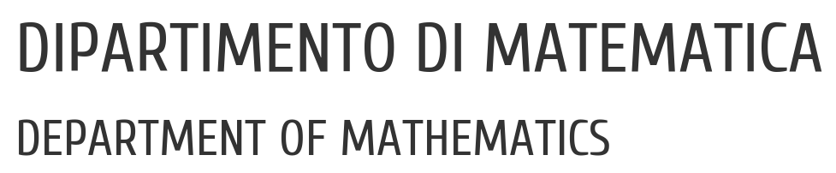

UNIVERSITY OF PADUA
UNIVERSITA’ DEGLI STUDI DI PADOVA
Instance Segmentation of Urban Street Scenes
Francesco Bari, Eleonora Signor
Vision and Cognitive Services - Prof. Lamberto Ballan
21 Febbraio 2022

Slide 2



UNIVERSITY OF PADUA
UNIVERSITA’ DEGLI STUDI DI PADOVA
Table of contents
Introduction
Related Work
Datasets
Method
Experiments
Conclusion
HOW?
WHY?
WHAT?

Slide 3

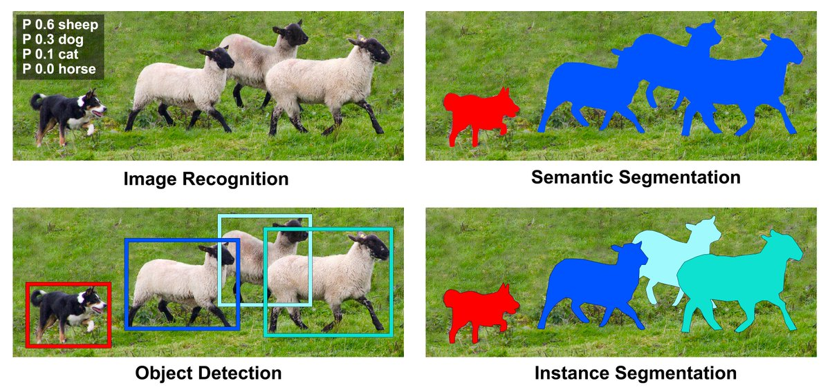
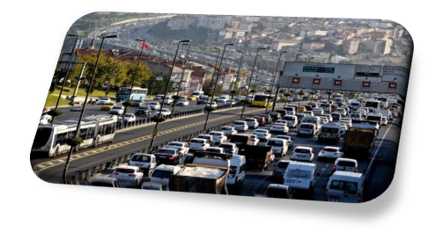
UNIVERSITY OF PADUA
UNIVERSITA’ DEGLI STUDI DI PADOVA
Introduction
instance segmentation for Urban Street Scenes

Slide 4
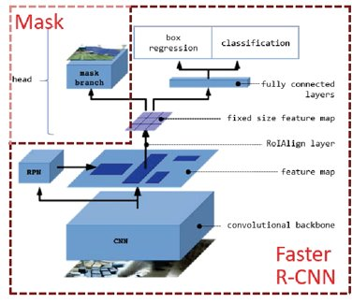
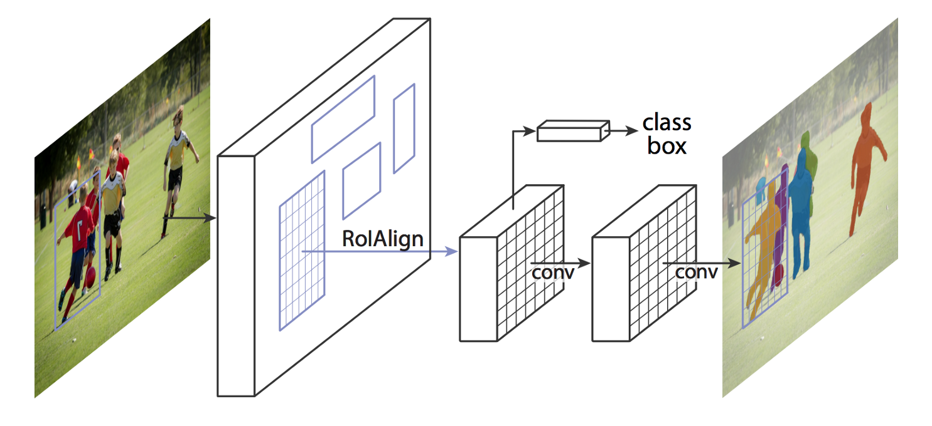


UNIVERSITY OF PADUA
UNIVERSITA’ DEGLI STUDI DI PADOVA
Related Work : stage approch, Mask R-CNN
box - based two stage approch
generates a segmentation mask for each instance
Region Proposal Network
class label, bounding box offset and object mask
backbone and head
RoIAlign
complicated scenarios
multi-task networks

Slide 5
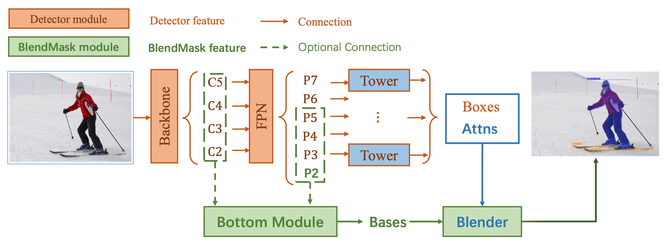
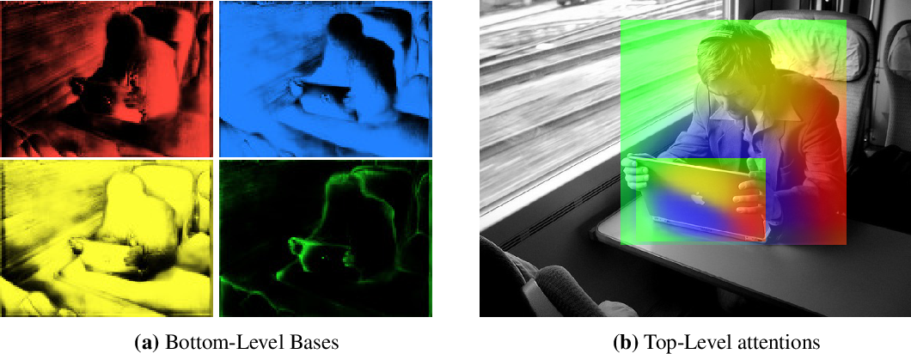


UNIVERSITY OF PADUA
UNIVERSITA’ DEGLI STUDI DI PADOVA
Related Work : stage approch, BlendMask
from the limits of Mask R-CNN
anchor box-free one-stage approach
it is composed of 3 parts:
- bottom module deals with the production of the bases
- top layer a single convolution layer, one for each tower. Predictions attention instances;
- blender module combines bases with attentions
theoretically better in time and precision

Slide 6

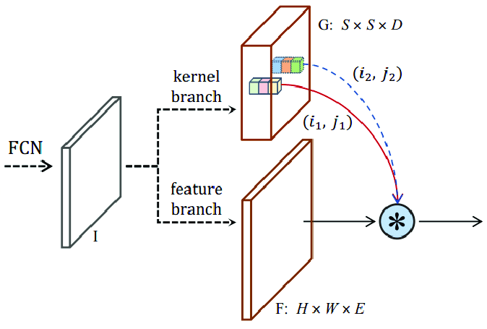
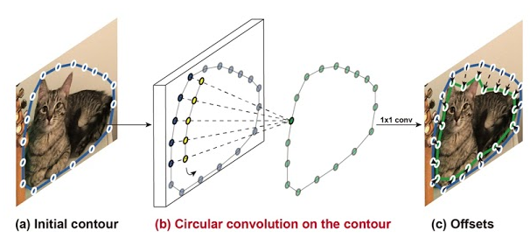
UNIVERSITY OF PADUA
UNIVERSITA’ DEGLI STUDI DI PADOVA
Related Work : others
SOLOv2
Deep Snake
box-free one-stage approach
mask kernel prediction and mask feature learning
matrix non-maximum suppression (NMS)
contour-based approach
initial contour proposal iteratively deforms
Circular Convolution

Slide 7
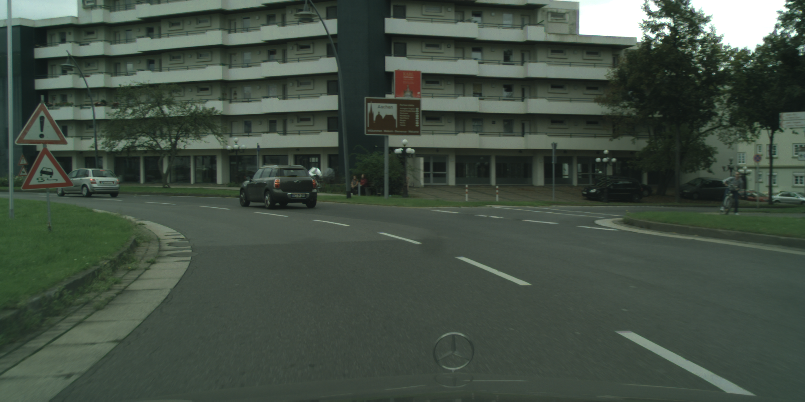
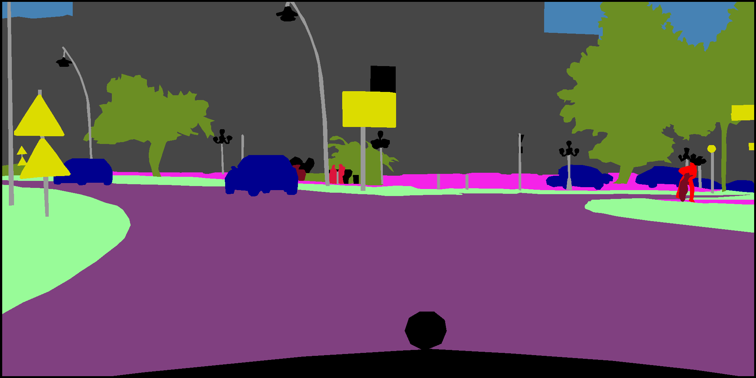
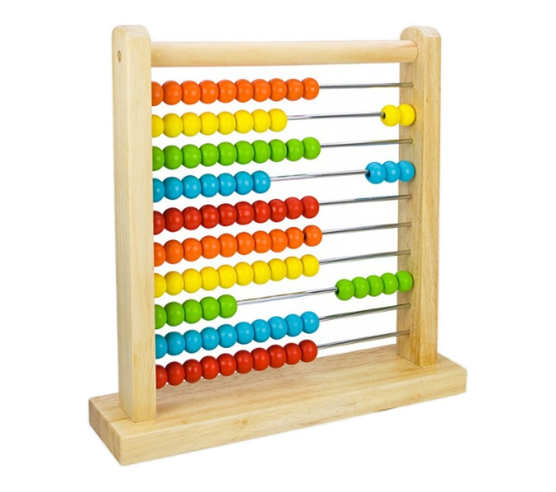

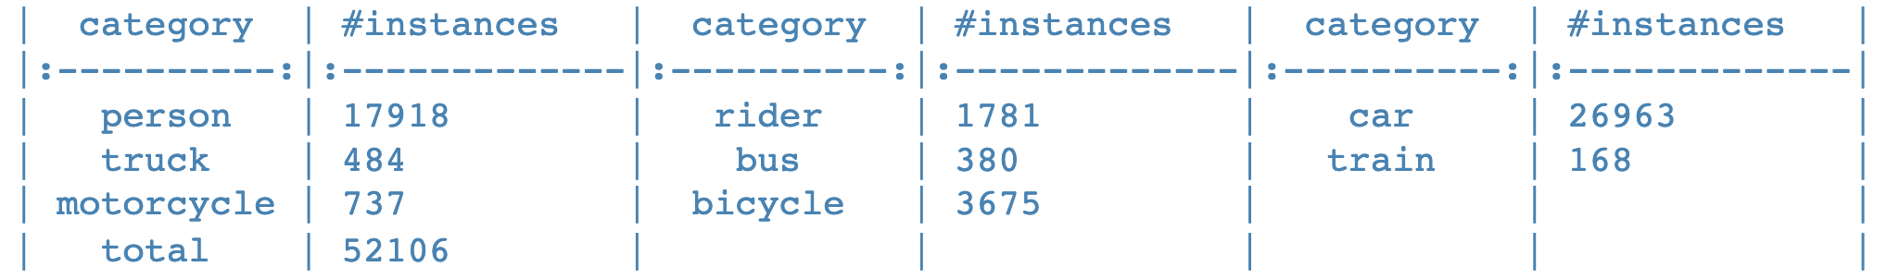

UNIVERSITY OF PADUA
UNIVERSITA’ DEGLI STUDI DI PADOVA
Datasets: Cityscapes
benchmarks and large-scale datasets for semantic urban scene understanding
Video sequences, recorded in 50 different cities
high-quality annotations, or/and coarse annotation
gtFine and leftImg8
HOW MUTCH?
3475 train/val images
1525 test images
5000 total images
8 total classes
PROBLEM: always images in good weather conditions

Slide 8
UNIVERSITY OF PADUA
UNIVERSITA’ DEGLI STUDI DI PADOVA
Datasets: WildDash
ELE

Slide 9
UNIVERSITY OF PADUA
UNIVERSITA’ DEGLI STUDI DI PADOVA
Method
ELE

Slide 10
UNIVERSITY OF PADUA
UNIVERSITA’ DEGLI STUDI DI PADOVA
Method: architecture
ELE

Slide 11
UNIVERSITY OF PADUA
UNIVERSITA’ DEGLI STUDI DI PADOVA
Method: hyperparameters

Slide 12
UNIVERSITY OF PADUA
UNIVERSITA’ DEGLI STUDI DI PADOVA
Method: loss functions

Slide 13
UNIVERSITY OF PADUA
UNIVERSITA’ DEGLI STUDI DI PADOVA
Method: evaluation

Slide 14
UNIVERSITY OF PADUA
UNIVERSITA’ DEGLI STUDI DI PADOVA
Experiments

Slide 15
UNIVERSITY OF PADUA
UNIVERSITA’ DEGLI STUDI DI PADOVA
Experiments: backbone

Slide 16
UNIVERSITY OF PADUA
UNIVERSITA’ DEGLI STUDI DI PADOVA
Experiments: frozen layers

Slide 17
UNIVERSITY OF PADUA
UNIVERSITA’ DEGLI STUDI DI PADOVA
Experiments: Ideal Models

Slide 18
UNIVERSITY OF PADUA
UNIVERSITA’ DEGLI STUDI DI PADOVA
Experiments: results

Slide 19
UNIVERSITY OF PADUA
UNIVERSITA’ DEGLI STUDI DI PADOVA
Conclusion: BlendMask vs SOLOv2
ELE

Slide 20
UNIVERSITY OF PADUA
UNIVERSITA’ DEGLI STUDI DI PADOVA
Conclusion: … and Deep Snake
ELE

Slide 21
UNIVERSITY OF PADUA
UNIVERSITA’ DEGLI STUDI DI PADOVA
Conclusion: possibile extensions
ELE

Slide 22
UNIVERSITY OF PADUA
UNIVERSITA’ DEGLI STUDI DI PADOVA
Progetto nome
Grazie per l’attenzione!

